Slide 1
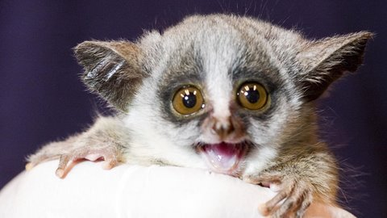
You’re Keeping Me Up All Night and Dialogue 6

Slide 2
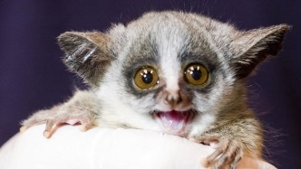
Bushbaby, you like to wake about the same time that I’m ending my day.
So, when I’m brushing my teeth and I’m falling asleep, you are starting you jump and play.
Get off of my roof! My tired eyes are the proof!
You jump all about as you scream and shout and you’re keeping me up all night.
Bushbaby, your big, round eyes make up for the fact there’s no sun in the sky.
You can swing in the trees as easy as you please. Why don’t you swing your way out of here?
Get off of my roof! My tired eyes are the proof! You jump all about as you scream and shout and you’re keeping me up all night.
You pick things up so easily like other members of the primate family.

Slide 3
You’re not very big so tell me why you sound like a human when you cry-eye-eye!
Get off of my roof! My tired eyes are the proof!
You jump all about as you scream and shout and you’re keeping me
Keeping me, keeping me (YAWN!)
You’re keeping me up all night! BUSHBABY!

Slide 4
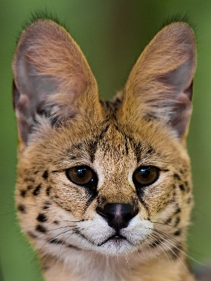
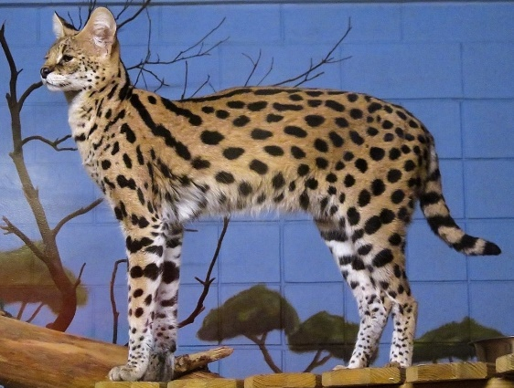
Dialogue 6
Wally: Look! SOMETHING is moving in the high grass! I think it’s one of the small cats.
Melissa: Look at the big ears on that cat!
Safari Guide 8: That’s right! Servals have good eyesight, but they also have bigger and better ears. In Africa, we say things twice when we really mean it, so we would say big, big ears.
Safari Guide 9: They hear so well, they can hear small animals running around in their underground burrows.
Wally: Those sneaky servals!

