Slide 1
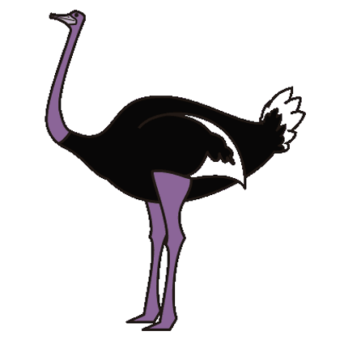
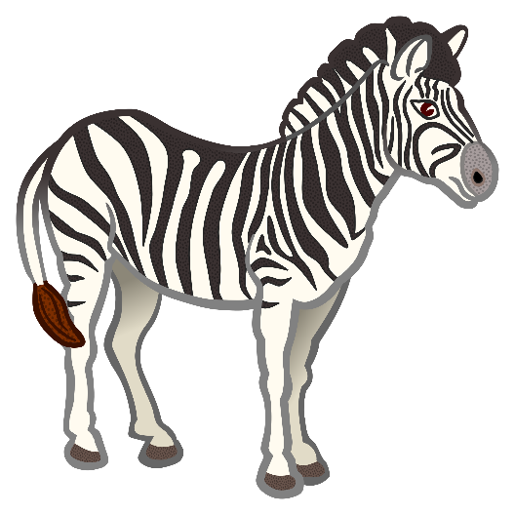
They Behave that Way and Dialogue 8

Slide 2
The crocodile needs a toothbrush to clean between its teeth.
The plover needs a food source and safety while it eats. So by working together, they both get what they need.
For who would harm an animal when it’s near a crocodile’s teeth?
They behave that way what they do each day.
Oh they help each other along.
They behave that way, what they do each day.
Oh they make each other strong.
The ostrich has good eyesight, but not good nose or ears.
The zebra has poor vision, bit it keenly smells and hears.
So, by working together, they both get what they need.
For one can hear and the other one sees the lion as it creeps.

Slide 3
They behave that way, what they do each day.
Oh, they help each other along.
They behave that way, what they do each day.
Oh, they make each other strong.
They know hoe to work together and help each other every day.
We should follow their example and do the same in work and play.
They behave that way, what they do each day.
Oh, they help each other along.
They behave that way, what they do each day.
Oh, they make each other strong.
Yes, they make each other strong!

Slide 4
Safari Guide 2: It’s almost time for you to go home, but there is on more animal we think you should see.
Safari Guide 3: Here in Africa, we have finished our rainy season, and the ground is still a bit muddy. When that happens, they prefer to stay close to the trees so they don’t slip, which makes them harder to find.
Didi: I think I hear them! Come! Let’s go in for a closer look.
Lilly: They’re beautiful!
Melissa: Wally! The perfect shot! Hurry before we lost the light.
Safari Guide 4: In this country, the only thing you may shoot animals with is a camera.
Safari Guide 5: Unfortunately, some people break the law. It’s called poaching.
Safari Guide 6: The park rangers try to find poachers before the poachers find the elephants, but sometimes they aren’t fast enough. We are losing elephants and other beautiful animals to poachers.
Didi: What can we do?
Safari Guide 7: Spread the word about poaching. Don’t buy anything that you think might be produced from poaching.
Safari Guide 8: And, for right now, we can enjoy the beauty of these wonderful animals!

