Slide 1
The Lion Doesn’t Sleep Tonight and Dialogue 2

Slide 2
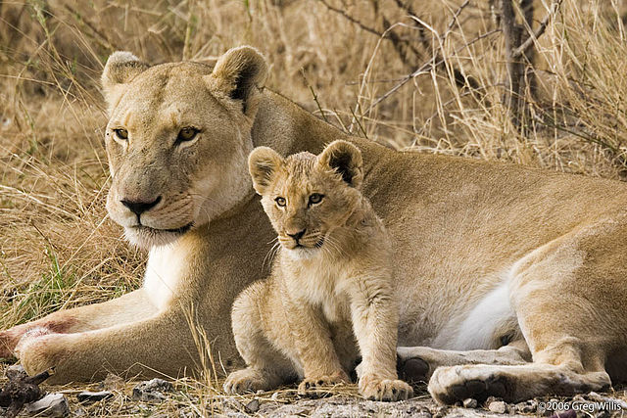
The Lion Doesn’t Sleep Tonight
The lion doesn’t sleep tonight, she’s up and on the prowl.
She creeps so very quietly beneath the sleeping fowl.
Be wary be watchful the lion doesn’t sleep tonight.
The lion doesn’t sleep tonight, she very softly creeps.
She works to feed her family while her cubs are fast asleep.
Be wary, be watchful, the lion doesn’t sleep tonight.
Sleep tonight.

Slide 3
Part III: Please be careful…
Part II: The silent lion softly creeps….
Part I: Lion doesn’t sleep. Lion doesn’t sleep. Lion doesn’t sleep. Oh, the lion doesn’t sleep tonight!
The lion doesn’t sleep tonight, she’s up and on the loose, lookin’ for a zebra or a wildebeest.
She’ll surprise them while they snooze.
Be wary, be watchful! The lion doesn’t sleep tonight.
Sleep tonight. The lion doesn’t sleep tonight. Tonight!

Slide 4
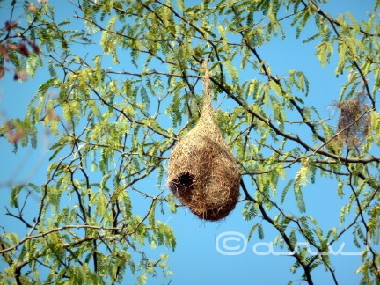
Dialogue 2
Lilly: Look at all those adorable little baskets hanging from the acacia tree! Are they for sale?
Safari Guide 5: These baskets aren’t baskets at all-they’re nests. They have to fly out and find some long grass.
Safari Guide 6: They pluck out the grass, fly back to the nest with the grass in their beak, and weave it into the nest. They build the nest one piece of grass at a time.
Didi: Yes, and I read somewhere that when he is done, he gets the female to come and inspect it. If she doesn’t like it, he chops it down and starts over!
Melissa: Now, that’s my kind of girl! What’s that hole at the bottom on the nest?
Safari Guide 7: That’s the doorway to get in and out of the nest. It helps the birds protect their eggs from predators.
Lilly: Oh, Mr. Charmingforge?
Ward: Yes, Mrs. Charmingforge?
Lilly: Do you think we could train a weaverbird to make me a purse? It would look so lovely with this outfit!

