Slide 1
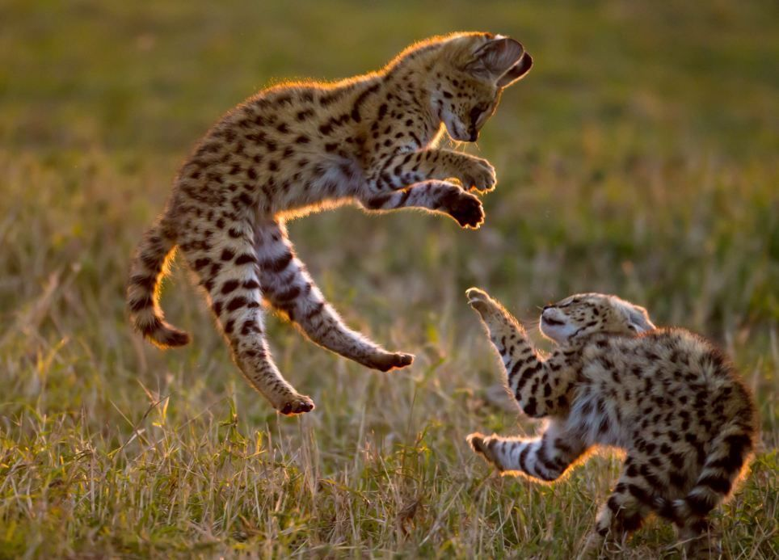
Sneaky Serval and Dialogue 7

Slide 2
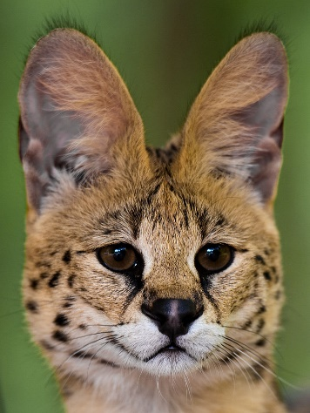
Who’s the cat with spots and stripes? The small, small cat with the big, big ears!
Only twenty inches high; the small, small cat with the big, big ears!
It doesn’t hunt with its eyes. The tall, tall grass gets in its way.
Still, it likes to surprise its lunch by pouncing on its prey.
Sneaky serval, a feline to be feared.
Sneaky serval goes hunting with its ears!
Who goes hunting just by sound? The small, small cat with the big, big ears!
Hearing things beneath the ground? The small ,small cat with the big, big ears!
It doesn’t hunt with its eyes. The tall, tall grass gets in its way.
Still, it likes to surprise its lunch by pouncing on its prey.
Sneaky serval, a feline to be feared.
Sneaky serval goes hunting with its ears!

Slide 3
It doesn’t hunt with its eyes. The tall, tall grass gets in its way.
Still, it likes to surprise its lunch by pouncing on its prey.
Sneaky serval, a feline to be feared.
Sneaky serval goes hunting, hunting with its ears!

Slide 4
Ward: Lilly, remind me to get my eyes checked when we get home. I think I’m seeing things.
Lilly: Well, what do you see?
Ward: DO you see that crocodile over there on the edge of the river?
Lilly: Yes
Ward: Well, it looks as if there is a….a bird picking food out of the crocodile’s teeth.
Lilly: Ward, I think you’re right!
Safari Guide 10: It’s an Egyptian Plover bird. The bird cleans the crocodile’s teeth and the crocodile doesn’t harm the bird.
Didi: I learned about this in school. Scientists call this symbiosis.
All: Symbi-WHAT sis?
Safari Guide 11: Symbiosis: Have you ever noticed that sometimes your friend is good at something that is difficult for you?
Safari Guide 12: And something that is easy for you is difficult for them, but if you work together, you can help each other and you both benefit?
Safari Guide 1: There are some great examples of symbiosis in African wildlife. Sometimes, animals with opposite strengths work together and make each other strong. Here are two examples.

