Slide 1
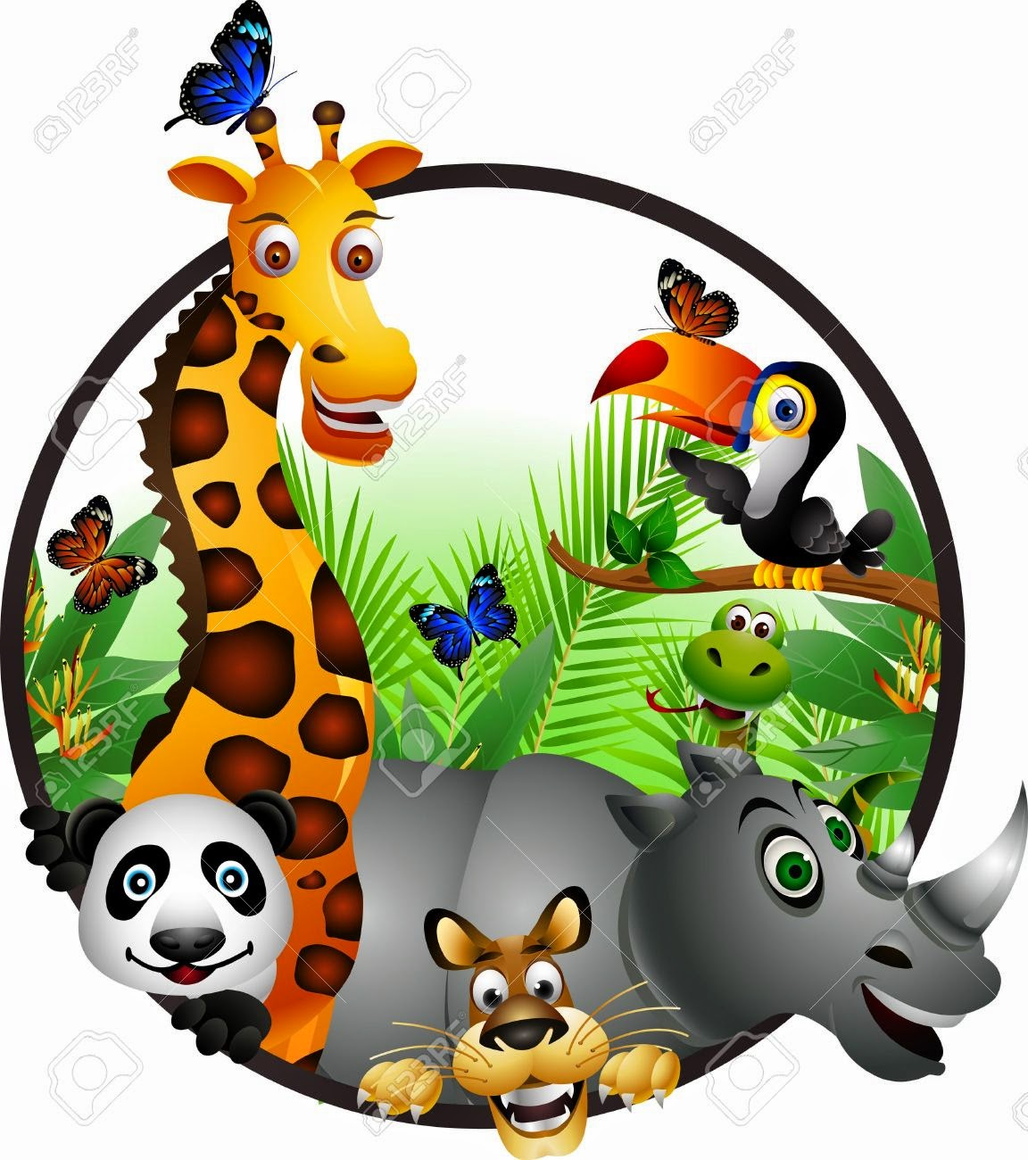
On Safari
and
Dialogue 1

Slide 2
On Safari
Jambo rafiki
Hello my friend
Kuja safari
Come on safari
Jambo rafiki.
Hello my friend
Karibunisana
We are glad you’re with us.
I know a place where the sun shines bright, and the lions keep roaring all through the night.
The baboon calls it home and cape buffalo roam, and the eagles are flying high.
I know a place where talk grasses sway, and the laughing hyena can run and play
So many antelope oh, come on let’s go!
Won’t you join me in Africa?

Slide 3
On safari, sunlight sizzles in the air
On safari, there’s adventure everywhere.
On safari, in sunshine or in rain
On safari, it’s never ever tame, on safari!
I know a place with acacia trees, and the elephants roam anywhere they please.
From the massive and tall, to the flying or small, there is wildlife from A to Z.
On safari, sunlight sizzles in the air
On safari, there’s adventure everywhere.
On safari, in sunshine or in rain
On safari, it’s never ever tame, on safari!
On safari, sunlight sizzles in the air
On safari, there’s adventure everywhere.
On safari, in sunshine or in rain
On safari, it’s never ever tame, on safari!
Kuja safari!

Slide 4
Dialogue 1
Safari Guide 1: Jambo na karibuni Africa! Hello and welcome to Africa! You were very smart to come early in the morning before the sun rises and the air is still cool.
Safari Guide 2: We are doing our best to make sure you see as many different animals as possible. It’s usually easy to find bigger animals, like the elephant and giraffe…
Melissa: Wonderful! I’ll look GREAT in a shot with a giraffe!
Safari Guide 3: ….but we also are working hard to find some animals that you have probably never seen before.
Didi: Cool! We learned in my science class about some of the smaller animals. I hope we get to see a serval-or maybe a warthog!
Ward: Well, if your friends can’t find the animals, we can just follow the other tourists to find the animals!
Safari Guide 4: We just got a report that the lions were spotted not far from here. The lions like to hunt at night under the cover of darkness.
Wally: I would love to see the male lions hunt! What a picture that would make!
Didi: But they don’t- their manes would get in the way. The males protect the pride, and the females do the hunting.
Lilly: SO keep your eyes peeled….we’re looking for lion!

