Slide 1
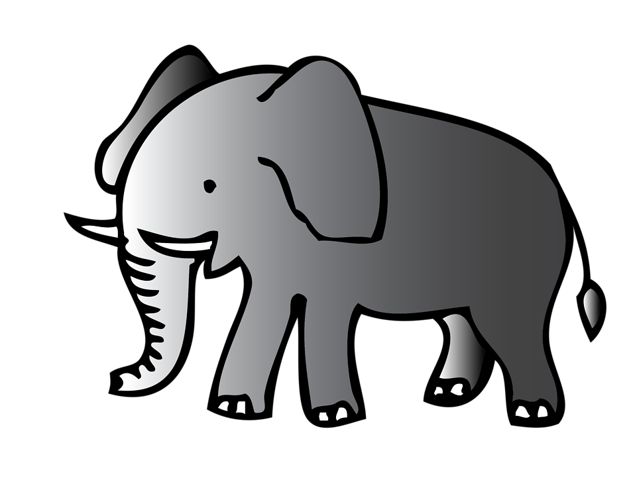
I Think it Might Be Elephants! Dialogue 9 Reprise: On Safari

Slide 2
All: I hear trumpeting from far away.
What animal does that to say “I’m warning you to stay away?”
I think it might be elephants
Walking
Voice 1: Oh, the elephants are walking (Repeat)
Voice 2: I see something in the bog, looking like an enormous long.
Who’s keeping cool in the smelly pool? I think it might be elephants!
All: Baby elephant passing by, in the shade of his mom, so high, with his twisting trunk bouncing as he goes, like a slinky in his nose.
Voice 1: Walking oh, the elephants are walking…(Repeat)
Voice 2: I hear crackling in the trees, deep in the bush where it’s hard to see. Who thinks bark is a special treat? I think it might be elephants.
All: I think it might be elephants!

Slide 3
Dialogue 9
Wally: This day went by so fast! The sun is about to set.
Lilly: And what beautiful sunsets you have in Africa!
Safari Guide 1: It’s Time for us to say goodbye so that you can travel back to your home. As we say in Swahili, Kwaheri! Goodbye!
Didi: Kwaheri!
Melissa: Asante!
Ward, Lilly, Wally: Thank you! Lovely day! We can’t wait to come back!

Slide 4
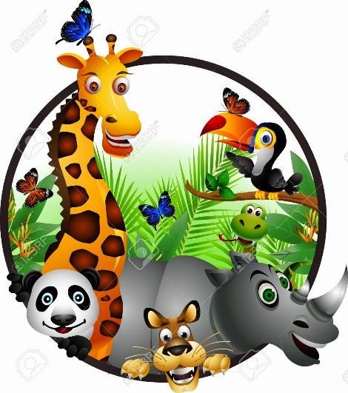
Reprise: On Safari
Solo: Kwaheri rafiki.
All: Goodbye, my friend.
Solo: Kwaheri Africa.
All: Goodbye to Africa.
We saw a place where the sun shines bright, and the lions keep roaring all through the night.
The baboon calls it home and cape buffalo roam, and the eagles are flying high.
We saw a place where tall grasses sway, and the laughing hyena can run and play.
So many antelope, glad we got to go!
We had fun there in Africa!
On safari, sunlight sizzles in the air.
On safari, there’s adventure everywhere.
On safari, in sunshine or in rain
On safari, it’s never ever tame, on safari! Kuja Safari!

