Slide 1
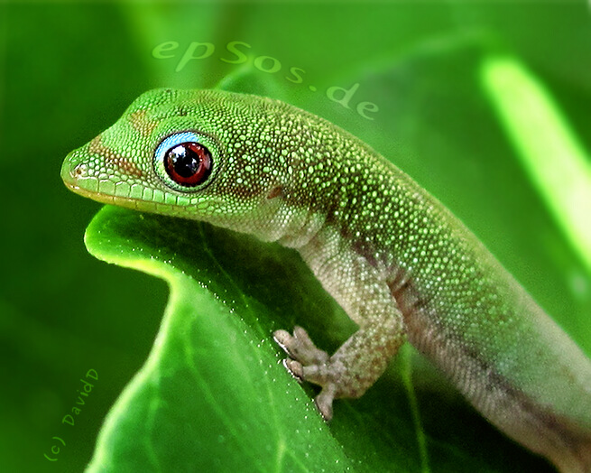
Gecko on the Hunt and Dialogue 5

Slide 2
Gecko on the Hunt
Gecko on the hunt!
When I’m hungry and it’s supper that I want, gecko on the hunt.
Gecko on the hunt!
When I’m hungry and it’s supper that I want, gecko on the hunt.
I’m on top of the wall looking down on the living room, searching for something good to eat.
Maybe a spider, maybe just a bug, a termite’s a very special treat.
Look!
A beetle, a munchy, crunchy beetle!

Slide 3
Gecko on the hunt!
When I’m hungry and it’s supper that I want, gecko on the hunt.
Gecko on the hunt!
When I’m hungry and it’s supper that I want, gecko on the hunt.
Running down the wall, I run very fast then freeze!
Swish, swish
Tail’s a swishin’ while I’m a thinkin.
Moving silently I’m so very sneaky.
I’m so close, it’s time to make my move.
Here I go! Yes! I got the beast!I’m gonna have a feast! Gecko on the hunt
Gecko on the hunt! I’m gonna have a feast you see!

Slide 4
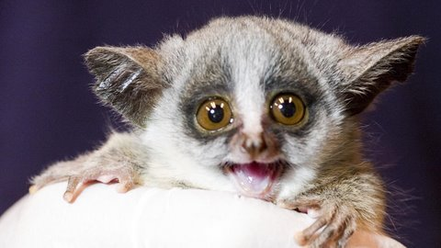
Melissa: Now, Wally I think we should…get a photo!
Wally: I’m sorry. I didn’t sleep well at all. There were these small, furry animals on my roof and they were jumping around and making crying noises all night long.
Safari Guide 4: Sounds like a bushbaby. They aren’t very big-about the size of a squirrel.
Safari Guide 5: They look like a lemur, only smaller, with multi-colored fur, big round eyes and a long curly tail. They can jump up twenty feet in a single bound!
Melissa: So, if they look like lemurs, who do they call them bushbabies? Do they have a bush mommy?
Safari Guide 6: They are called bushbabies because they are usually found in the countryside, which also called the bush, and their cry sounds like a human toddler crying.
Safari Guide 7: Plus, they are nocturnal, which means they are awake at night…and very social and noisy.
Wally: Oh, yes, they are! When they were on my roof last night I just wanted to climb up there and say to them, “Get off of my roof! I am trying to sleep down here!”

