Slide 1
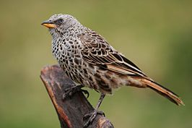
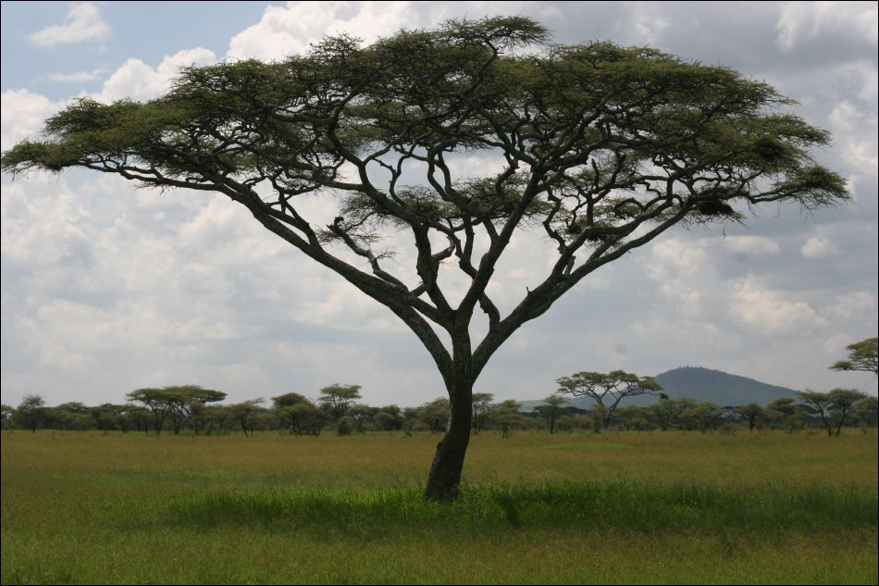
Acacia Hadn’t Noticed and Dialogue 3

Slide 2
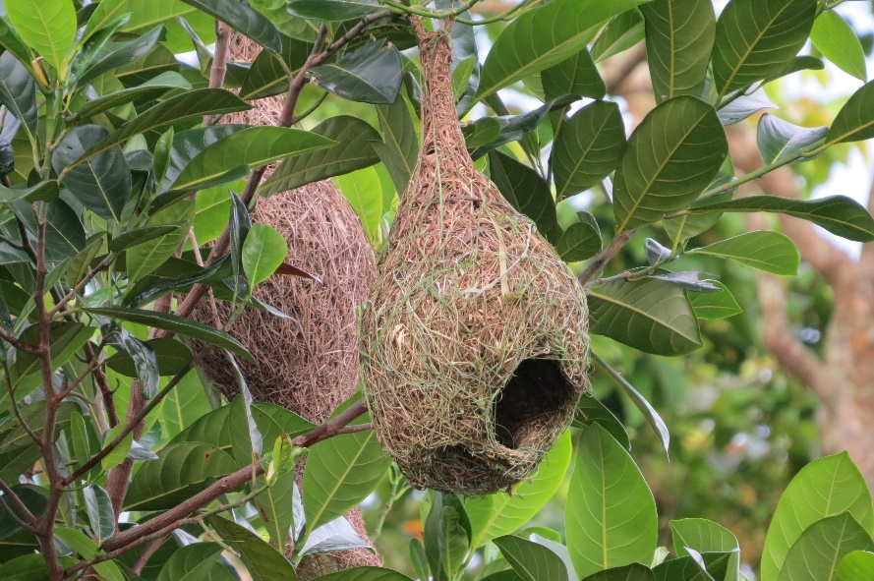
Acacia Hadn’t Noticed
Acacia hadn’t noticed there are baskets in the trees;
A woven piece of beauty on display for all to see.
These baskets are not fashioned by folks like you or me
But by little birds that only use their beaks and wings and feet.
Little weaverbird, your wings are small, but your hanging nests are the prettiest of all.
Flying here and there in grasses long, how we love to hear your happy song.

Slide 3
So when the rain’s a blowin’ in the middle of the storm, your eggs safely tucked away keep them safe and warm.
When trouble comes to harm you, there’s no need to fret or flee.
The doorway’s on the bottom to protect your family.
Little weaverbird, your wings are small,
But your hanging nests are the prettiest of all.
Flying here and there in grasses long, how we love to hear your happy song.

Slide 4
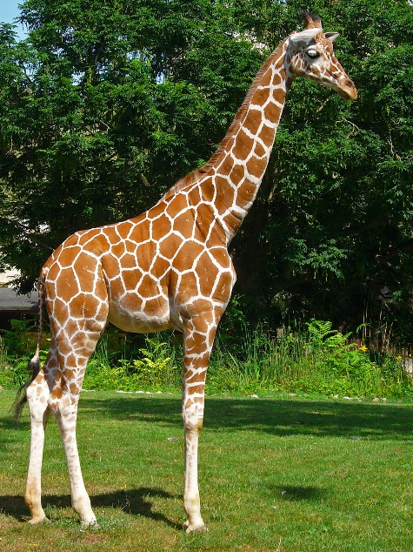
Dialogue 3
Safari Guide 1: Look! It is a twiga!
Ward: Gesundheit!
Safari Guide 2: I didn’t sneeze. I said Twiga! Twiga is the Swahili word for giraffe.
Melissa: Yes! Hey, Wally! It’s photo time!
Wally: I can’t get a good shot. The giraffe is too tall!
Safari Guide 3: Giraffes can grow up to 18 feet tall. Their legs are soooo long they have to spread them wide when the drink at the watering hole.
Safari Guide 4: That’s when they are most vulnerable to predators like crocodiles, lions, and even a leopard.
Safari Guide 5: They may be big, but they are not mean; and they aren’t noisy wither. They’re too busy eating acacia trees.

